Slide 1
DEP and ASLR in JOS
George P. Burdell

Slide 2
Problem Statement
No protection against buffer overflow attacks in JOS
Threat Model:
Attacker discovers stack buffer overflow vulnerability in software
Attacker deliberately overflows buffer to overwrite stack and redirect return address to:
Shellcode injected onto stack
Functions that already exist within the current process’s memory (ROP attack)
Attacker is usually trying to spawn a root shell (privilege escalation)

Slide 3
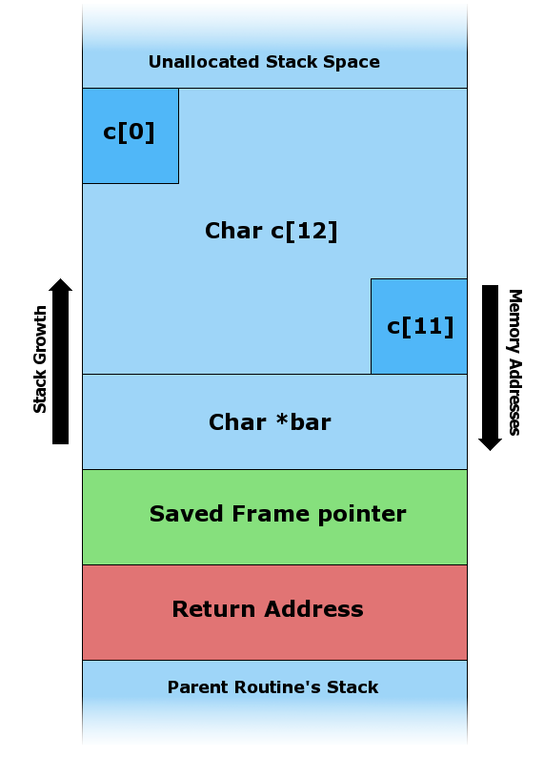
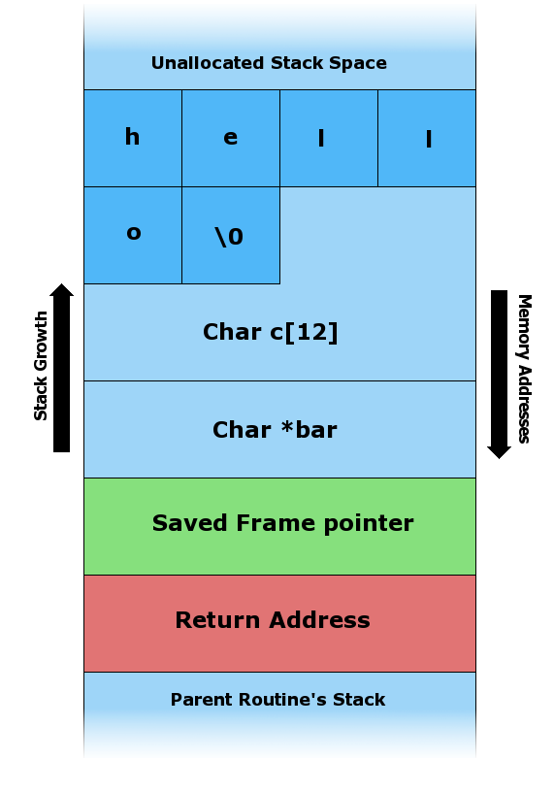
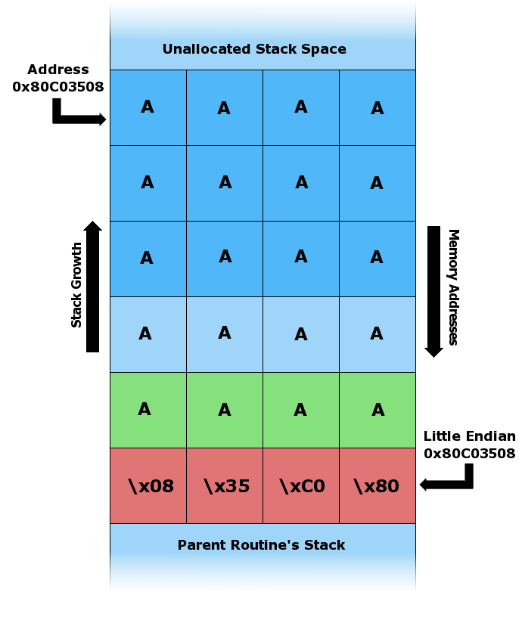
Stack Buffer Overflow

Slide 4
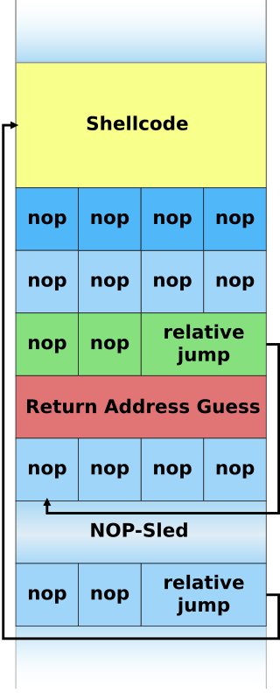
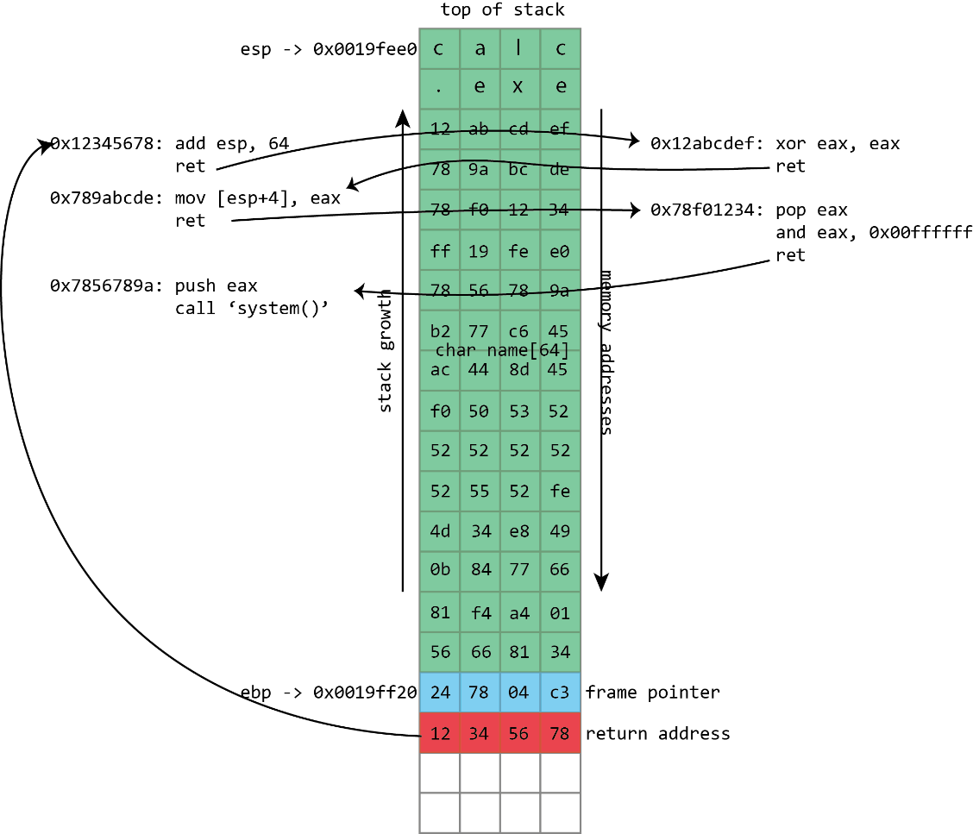
Return Address Redirection

Slide 5
Data Execution Prevention (DEP)
Make stack and heap memory regions nonexecutable
Intel 80386: set limit for CS in segment descriptor
Executing outside segment limit (e.g. stack or heap) triggers general protection fault!
Enforced at hardware level = no performance overhead
Prevents shellcode execution on stack
Does not protect against ROP – can still redirect return address to any executable code that already exists in process memory (e.g. system())

Slide 6
Address Space Layout Randomization (ASLR)
Randomize location of executable code (.text) in memory
Compile kernel/user programs as position-independent executables (PIE)
Load at random locations in memory
Attacker can no longer predict where things are located in memory
Effectiveness depends on amount of entropy (randomness)
Quick calculations for JOS:
Kernel: 256 MB space, page-aligned = 65536 possible locations or 16 bits of entropy
User: 3820 MB space, page-aligned = 977920 possible locations or 20 bits of entropy
ASLR most effective on 64-bit (super large virtual address space = much higher entropy)
Brute force searching infeasible

Slide 7
Demo Plan
Step through buffer overflow attack in JOS
How it works without protection mechanisms enabled
How DEP causes stack execution of injected shellcode to fail
How ASLR causes ROP attack to fail and how high entropy decreases effectiveness of brute forcing
Threat modeling
Sources of vulnerabilities and how to prevent them
Limitations of ASLR/DEP and methods of circumvention

Slide 8
Timeline
Week 1 – Research and planning
Week 2 – Implement DEP for kernel and user stacks
Week 3 – Implement ASLR for kernel and user code
Week 4 – Testing and debugging
Week 5 – Final writeup and demo preparation
Week 6 – Demo

